Slide 1
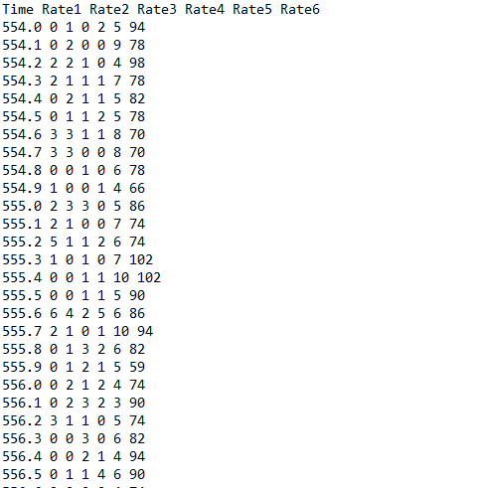
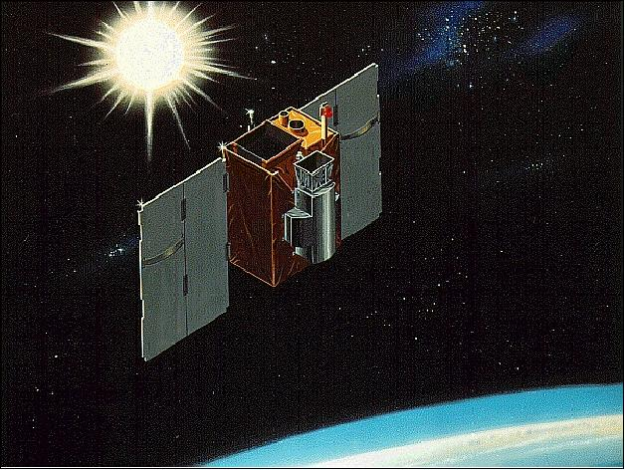
Pitch Angle Rounding

Slide 2
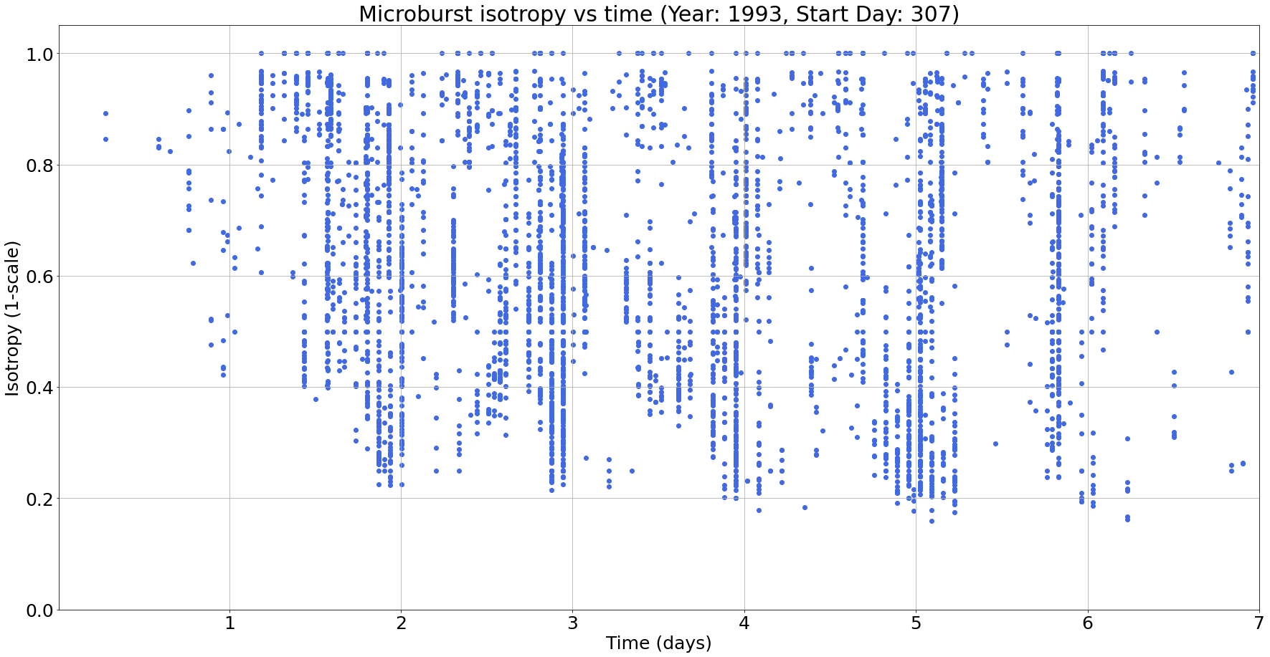
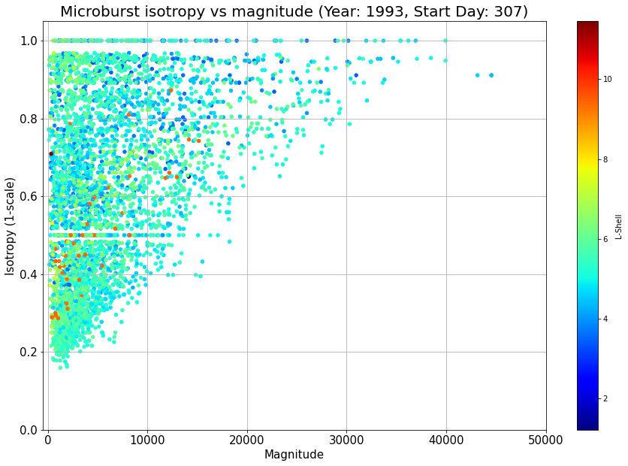
Data Gaps
Odd gaps in the data were noticed surrounding 0.5 and 1.0 (and other) isotropy values
1.0 line
0.5 line

Slide 3
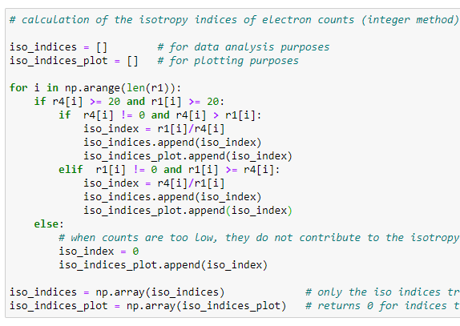
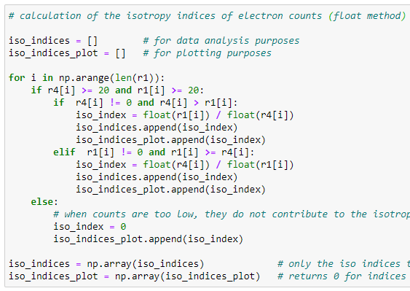
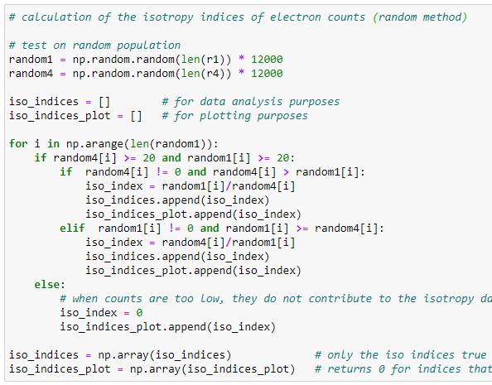
Data Gap Analysis
The 2 most likely causes of these lines/gaps:
Instrumentation rounding error
Error in the isotropy calculation code
To determine whether there is an issue in the code, the following 3 methods were used:
1. Integer Calculation: original isotropy calculation code for comparison
2. Float Calculation: float converted isotropy calculation code
3. Random Integer Calculation: original isotropy calculation code applied to random data set

Slide 4
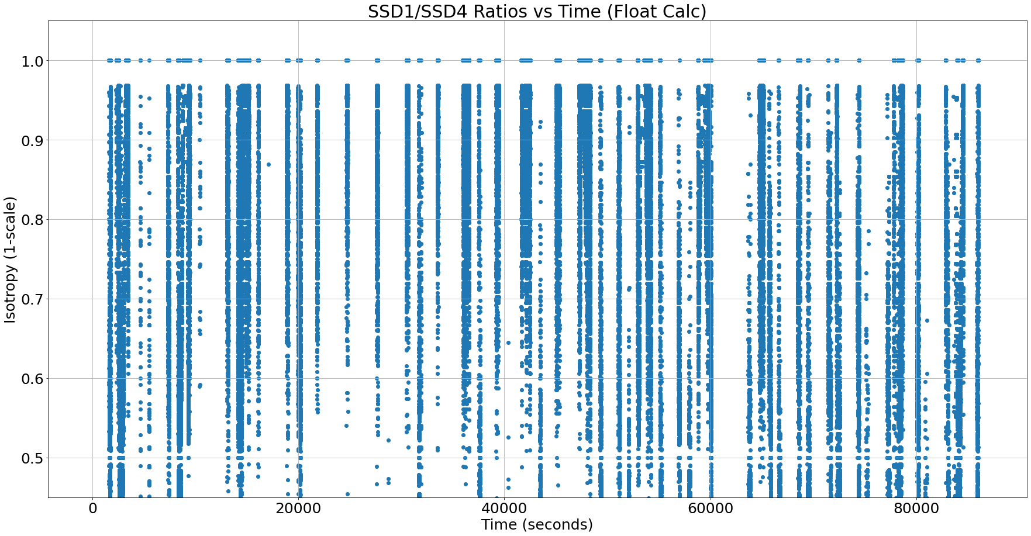

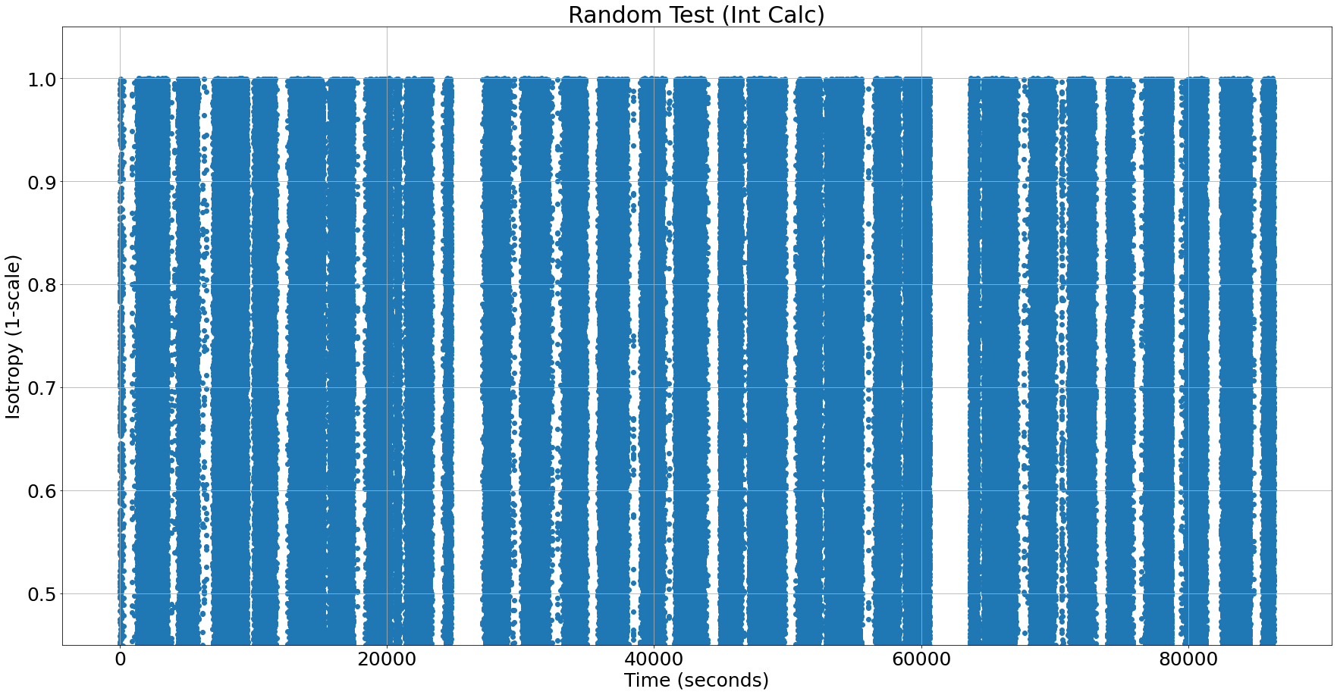
Results
2. Float Calculation: float converted isotropy calculation code
1. Integer Calculation: original isotropy calculation code for comparison
3. Random Integer Calculation: original isotropy calculation code applied to random data set

Slide 5
Conclusion
Count rounding appears to be caused by the spacecraft instruments and not related to our code

